Slide 1
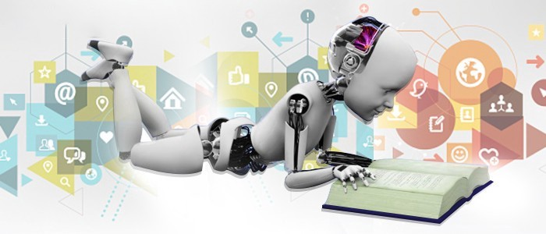
Data Science for Engineers
R. Joseph Manoj Ph.D.

Slide 2

Session Plan
Data Science Life Cycle
Roles in Data Science Life Cycle
Introduction to Machine Learning
Machine Learning Operationalization
Custom ML Model Development
ML Model Deployment in Azure
AutoML Model Development

Slide 3
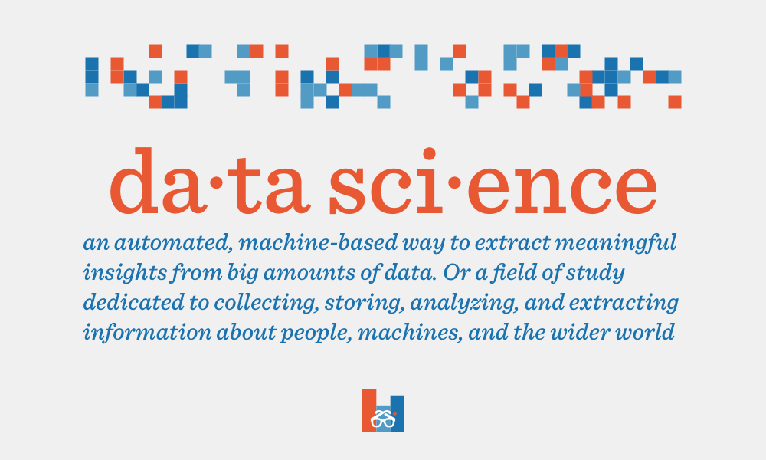

Slide 4
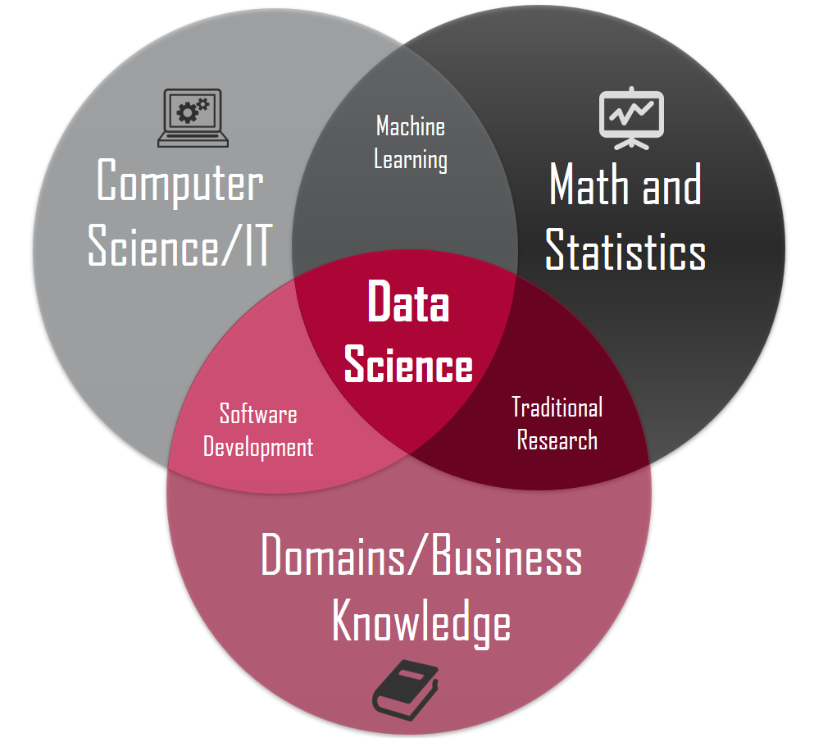

Slide 5
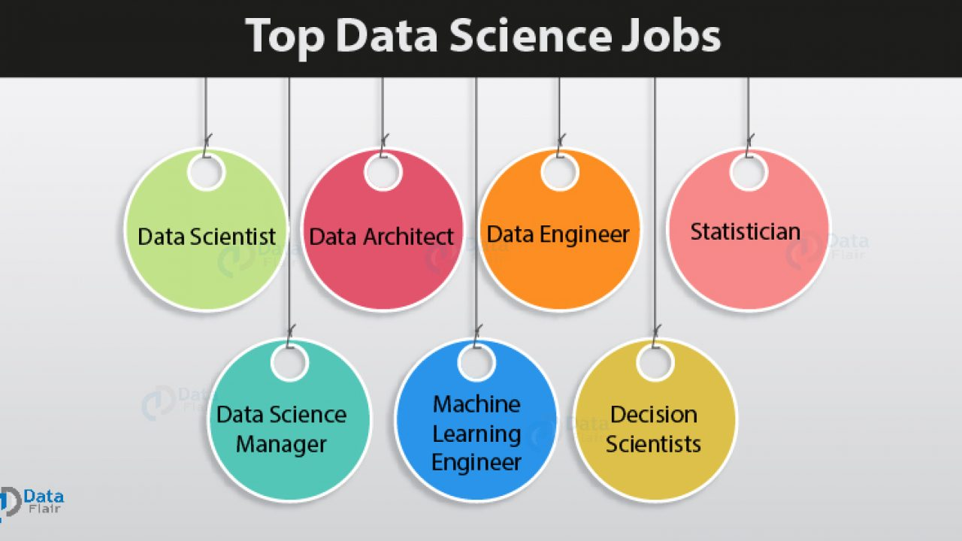

Slide 6
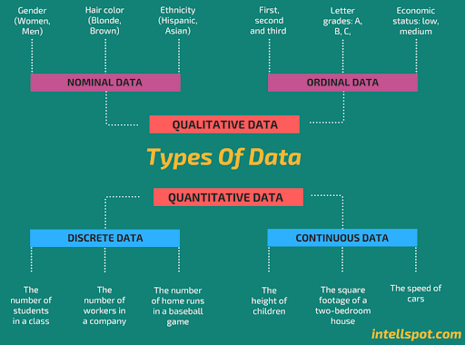
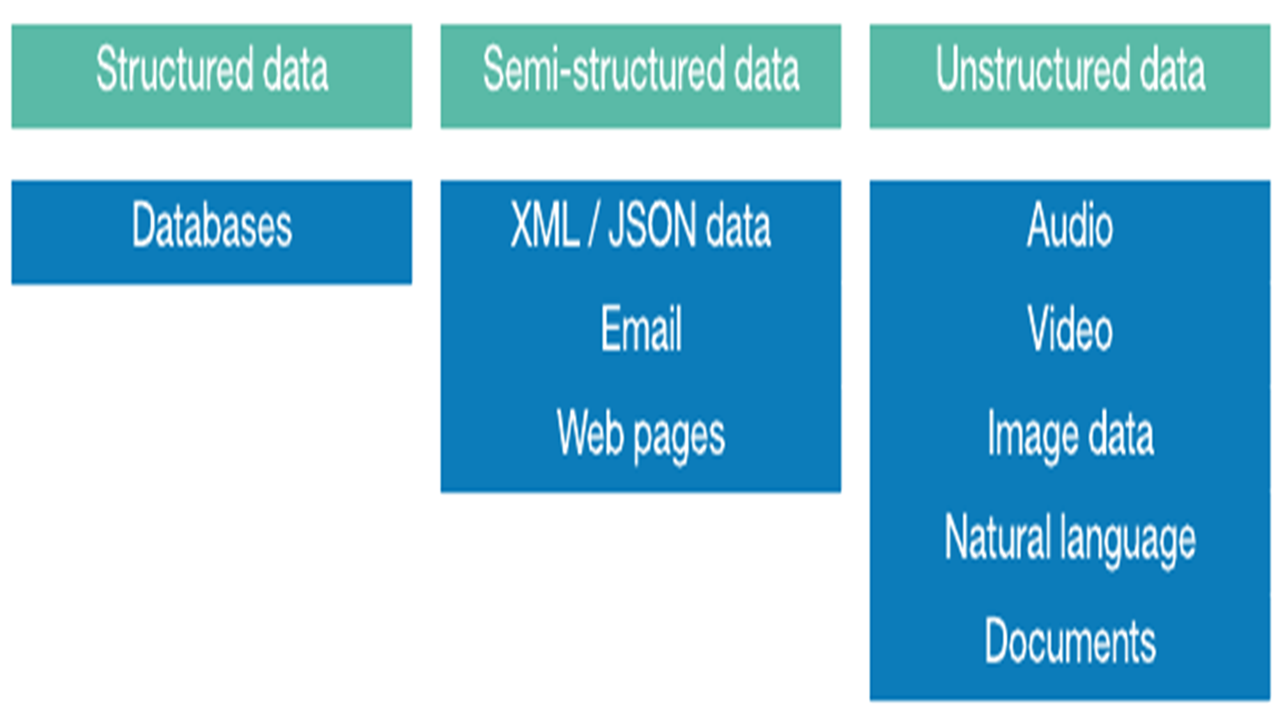

Slide 7
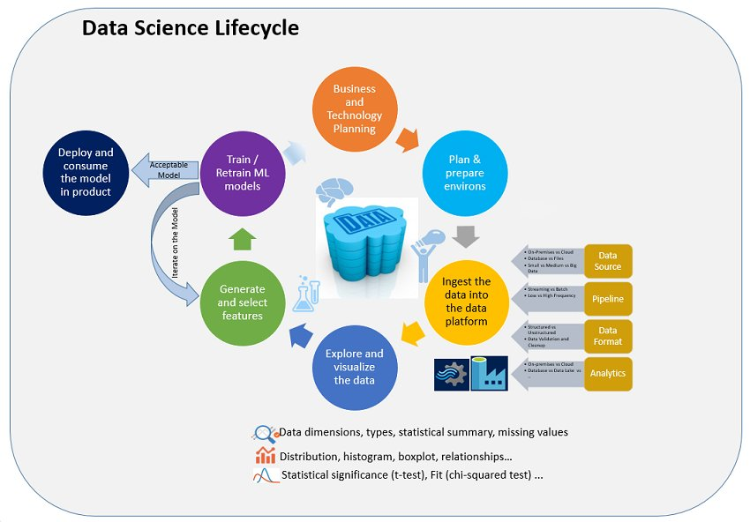

Slide 8
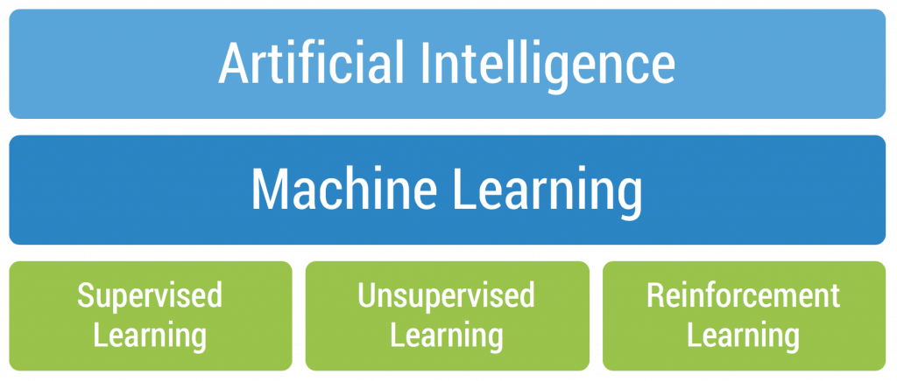
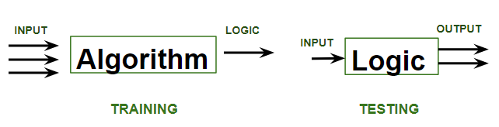
ML Algorithms – An Overview

Slide 9
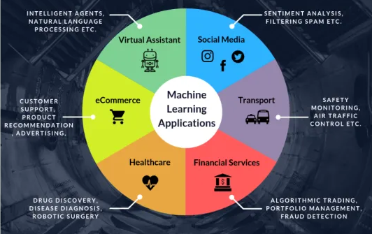

Slide 10
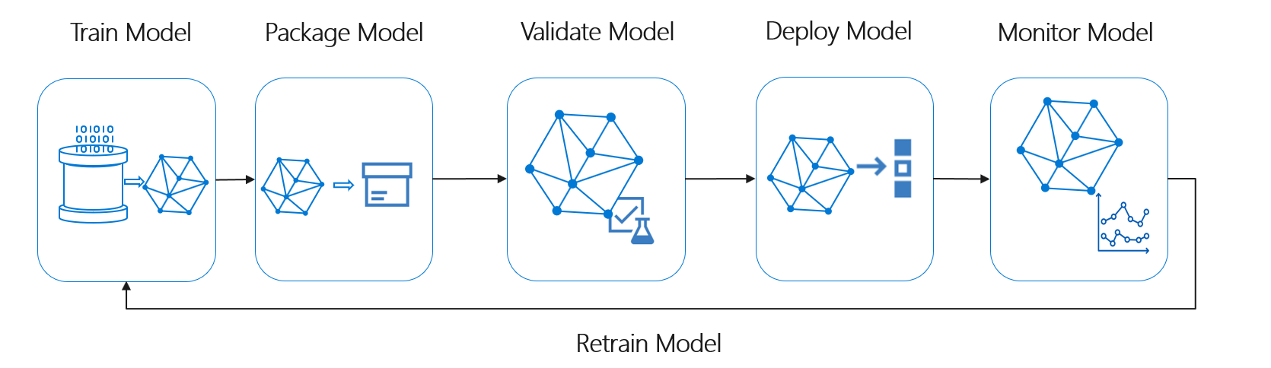
MLOps – ML Life Cycle Management

Slide 11
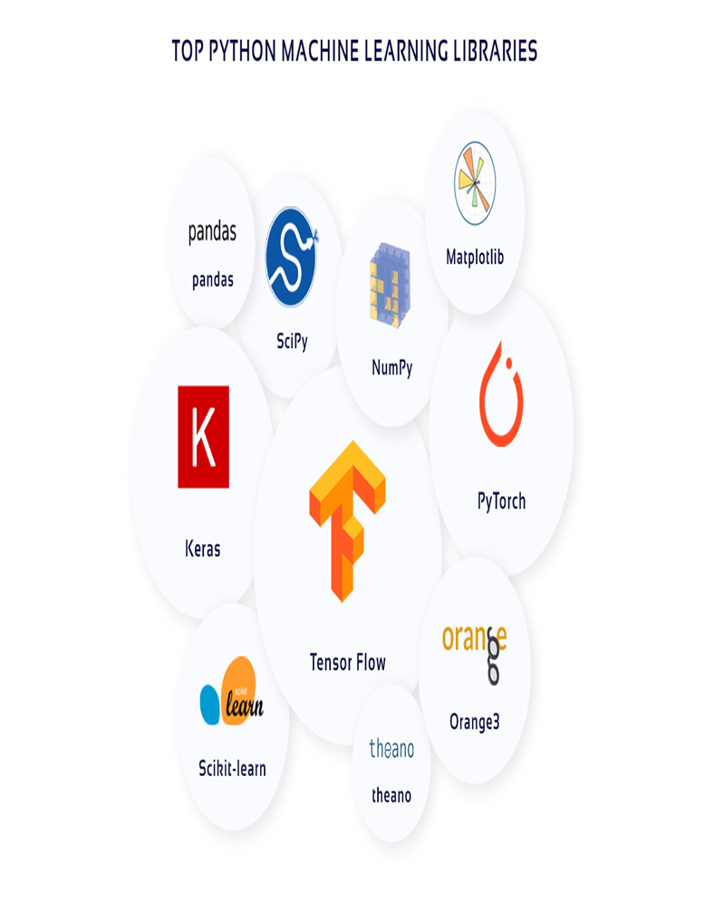
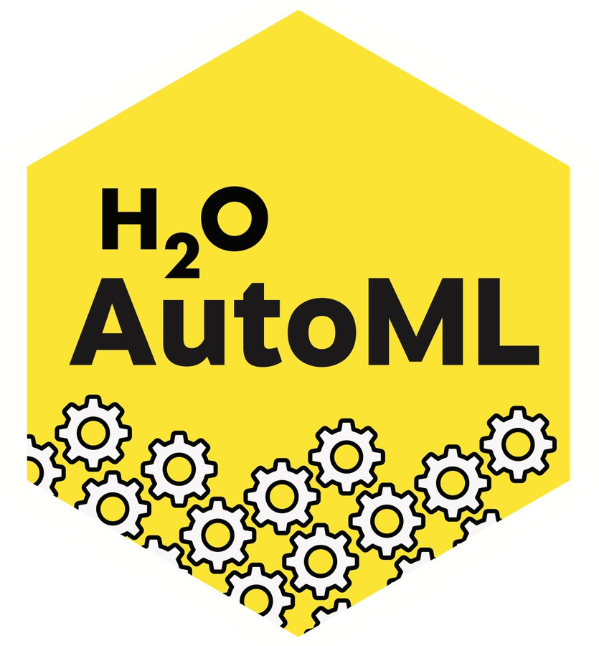
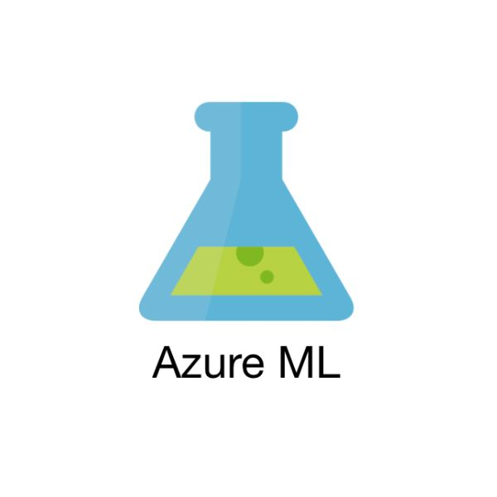

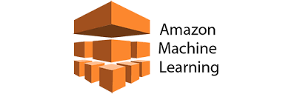
CustomML Vs AutoML

Slide 12


Slide 13

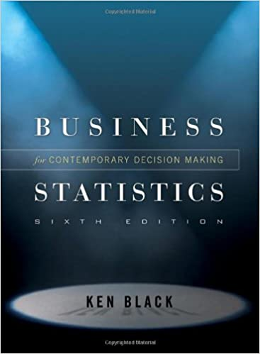
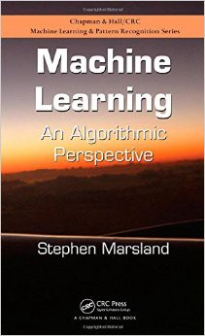



Slide 14

CustomML Development
Churn Prediction
ML Model Deployment in Azure Cloud

Slide 15


